Slide 1
Loving biology: adopting science
Adrian Mackenzie & Celia Roberts a.mackenzie@lancaster celia.roberts@lancaster.ac.uk

Slide 2
‘Following an ethical and methodological principle for science studies I adopted many years ago, I will critically analyse, or “deconstruct”, only that which I love and that in which I am deeply implicated’ (Haraway, 1997: 151).

Slide 3
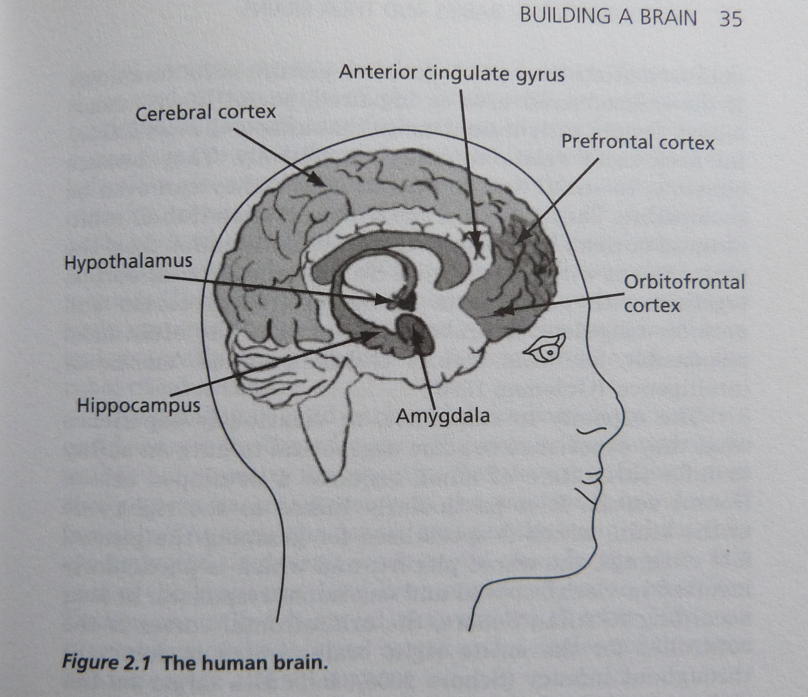

Slide 4
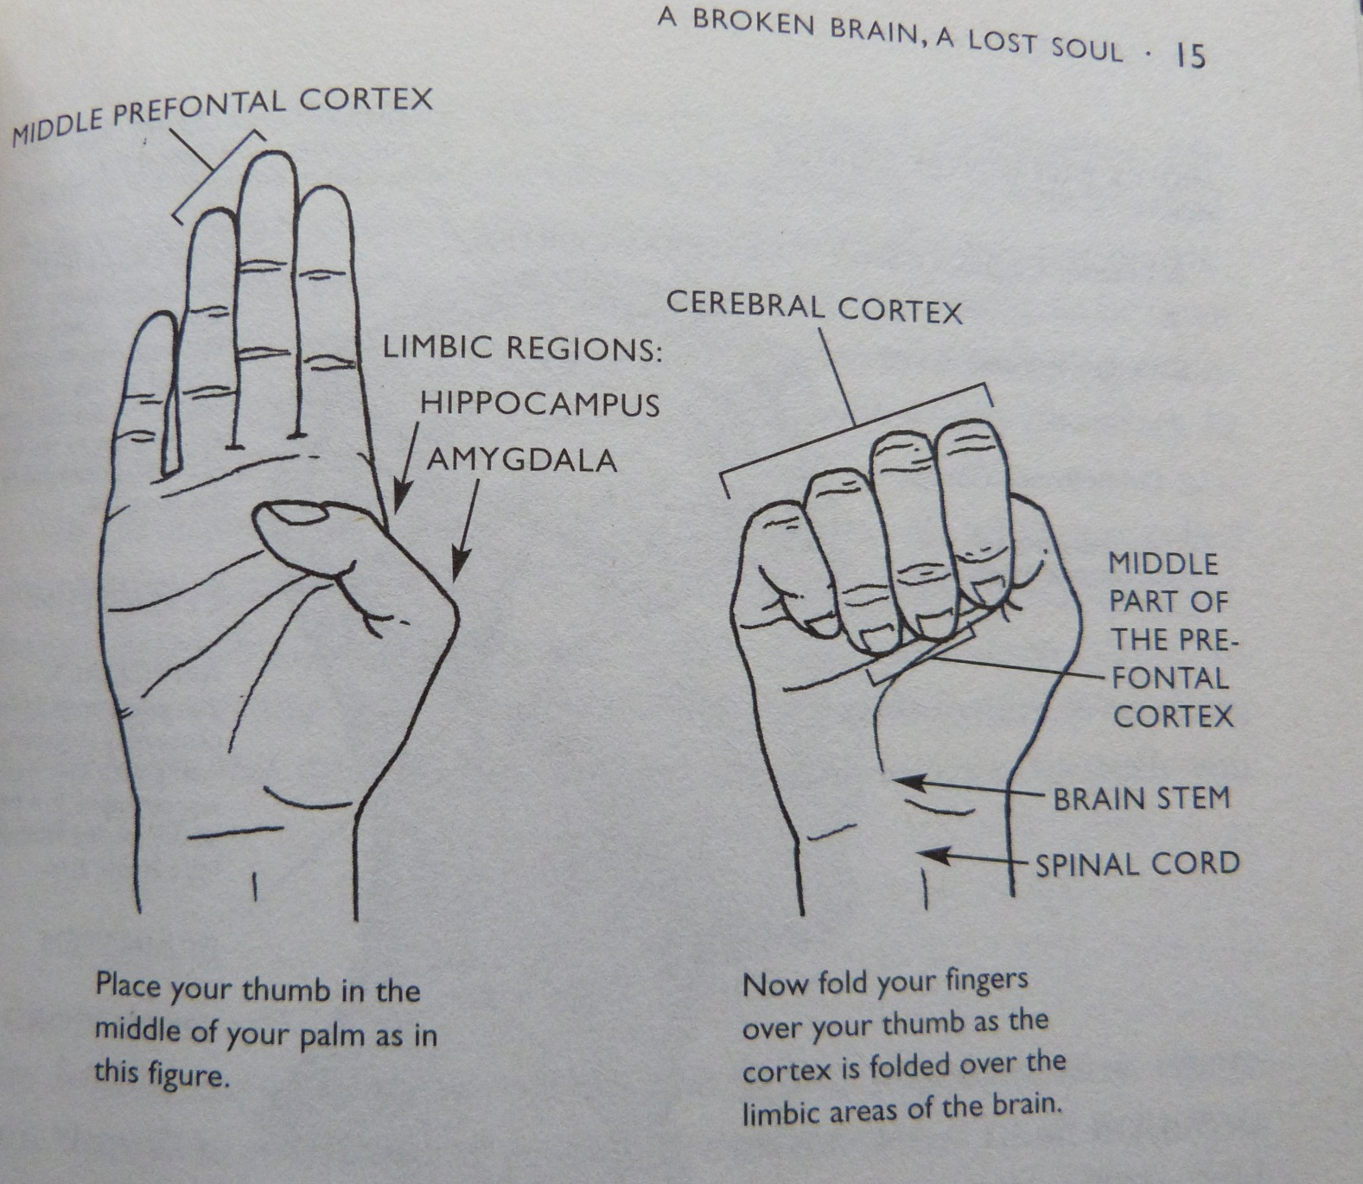

Slide 5
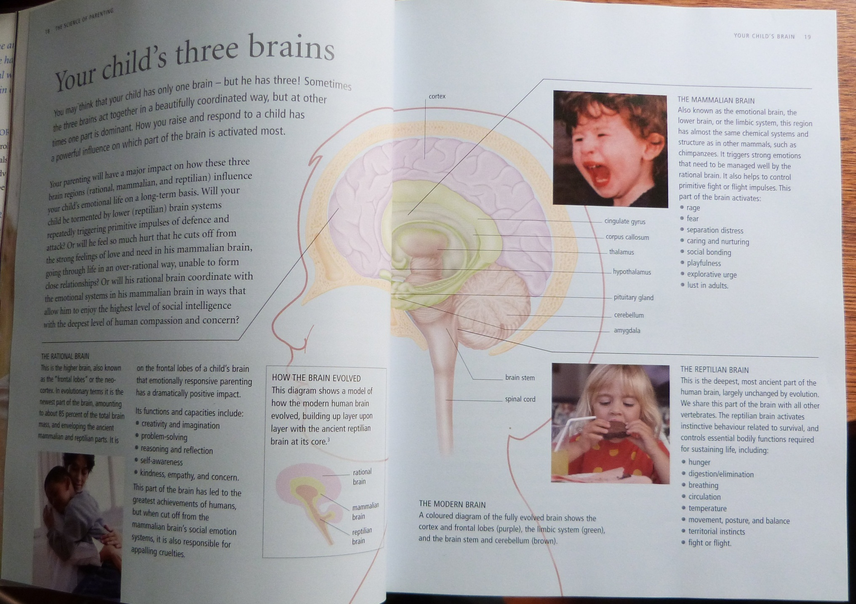

Slide 6
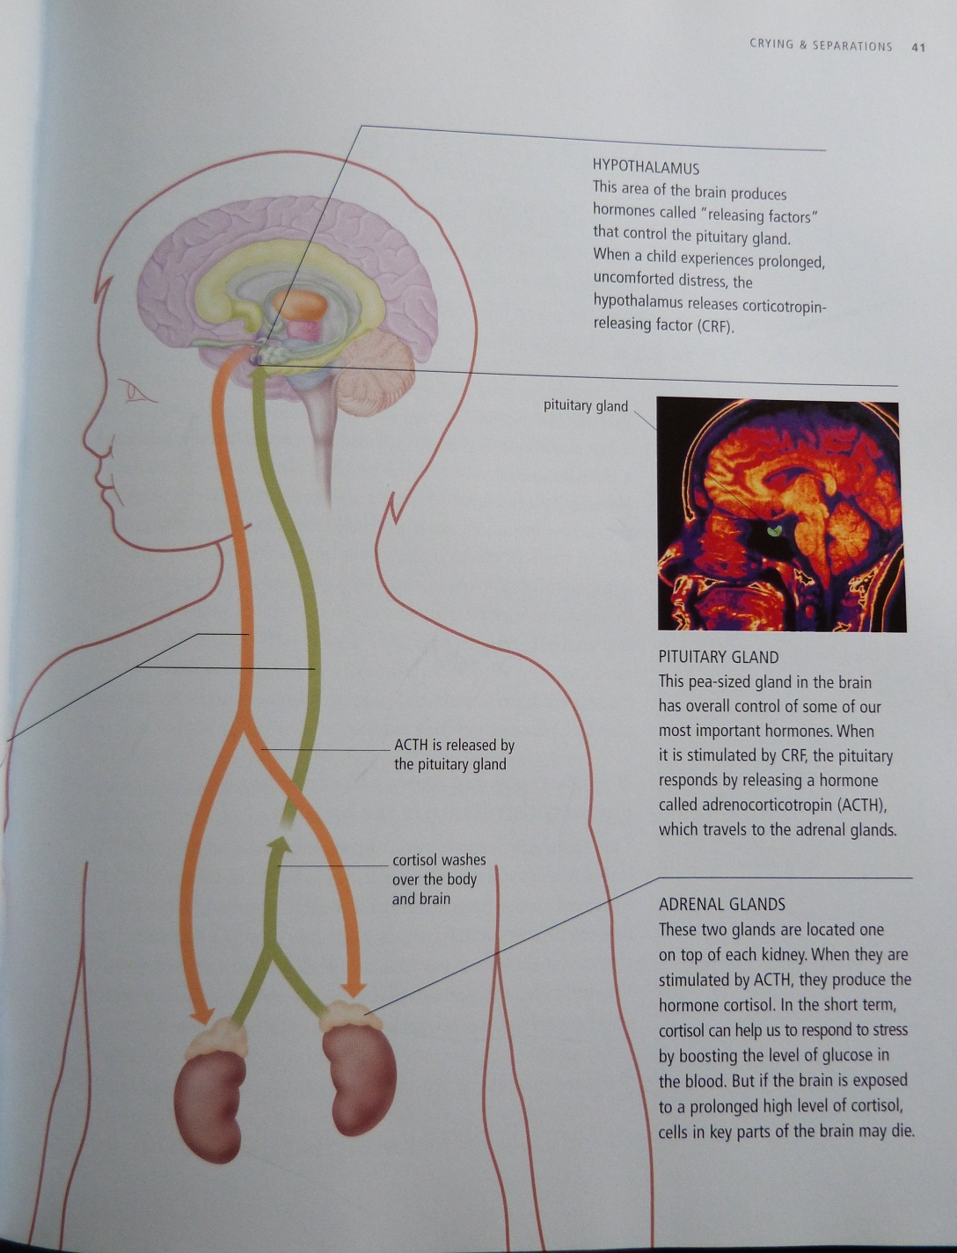

Slide 7
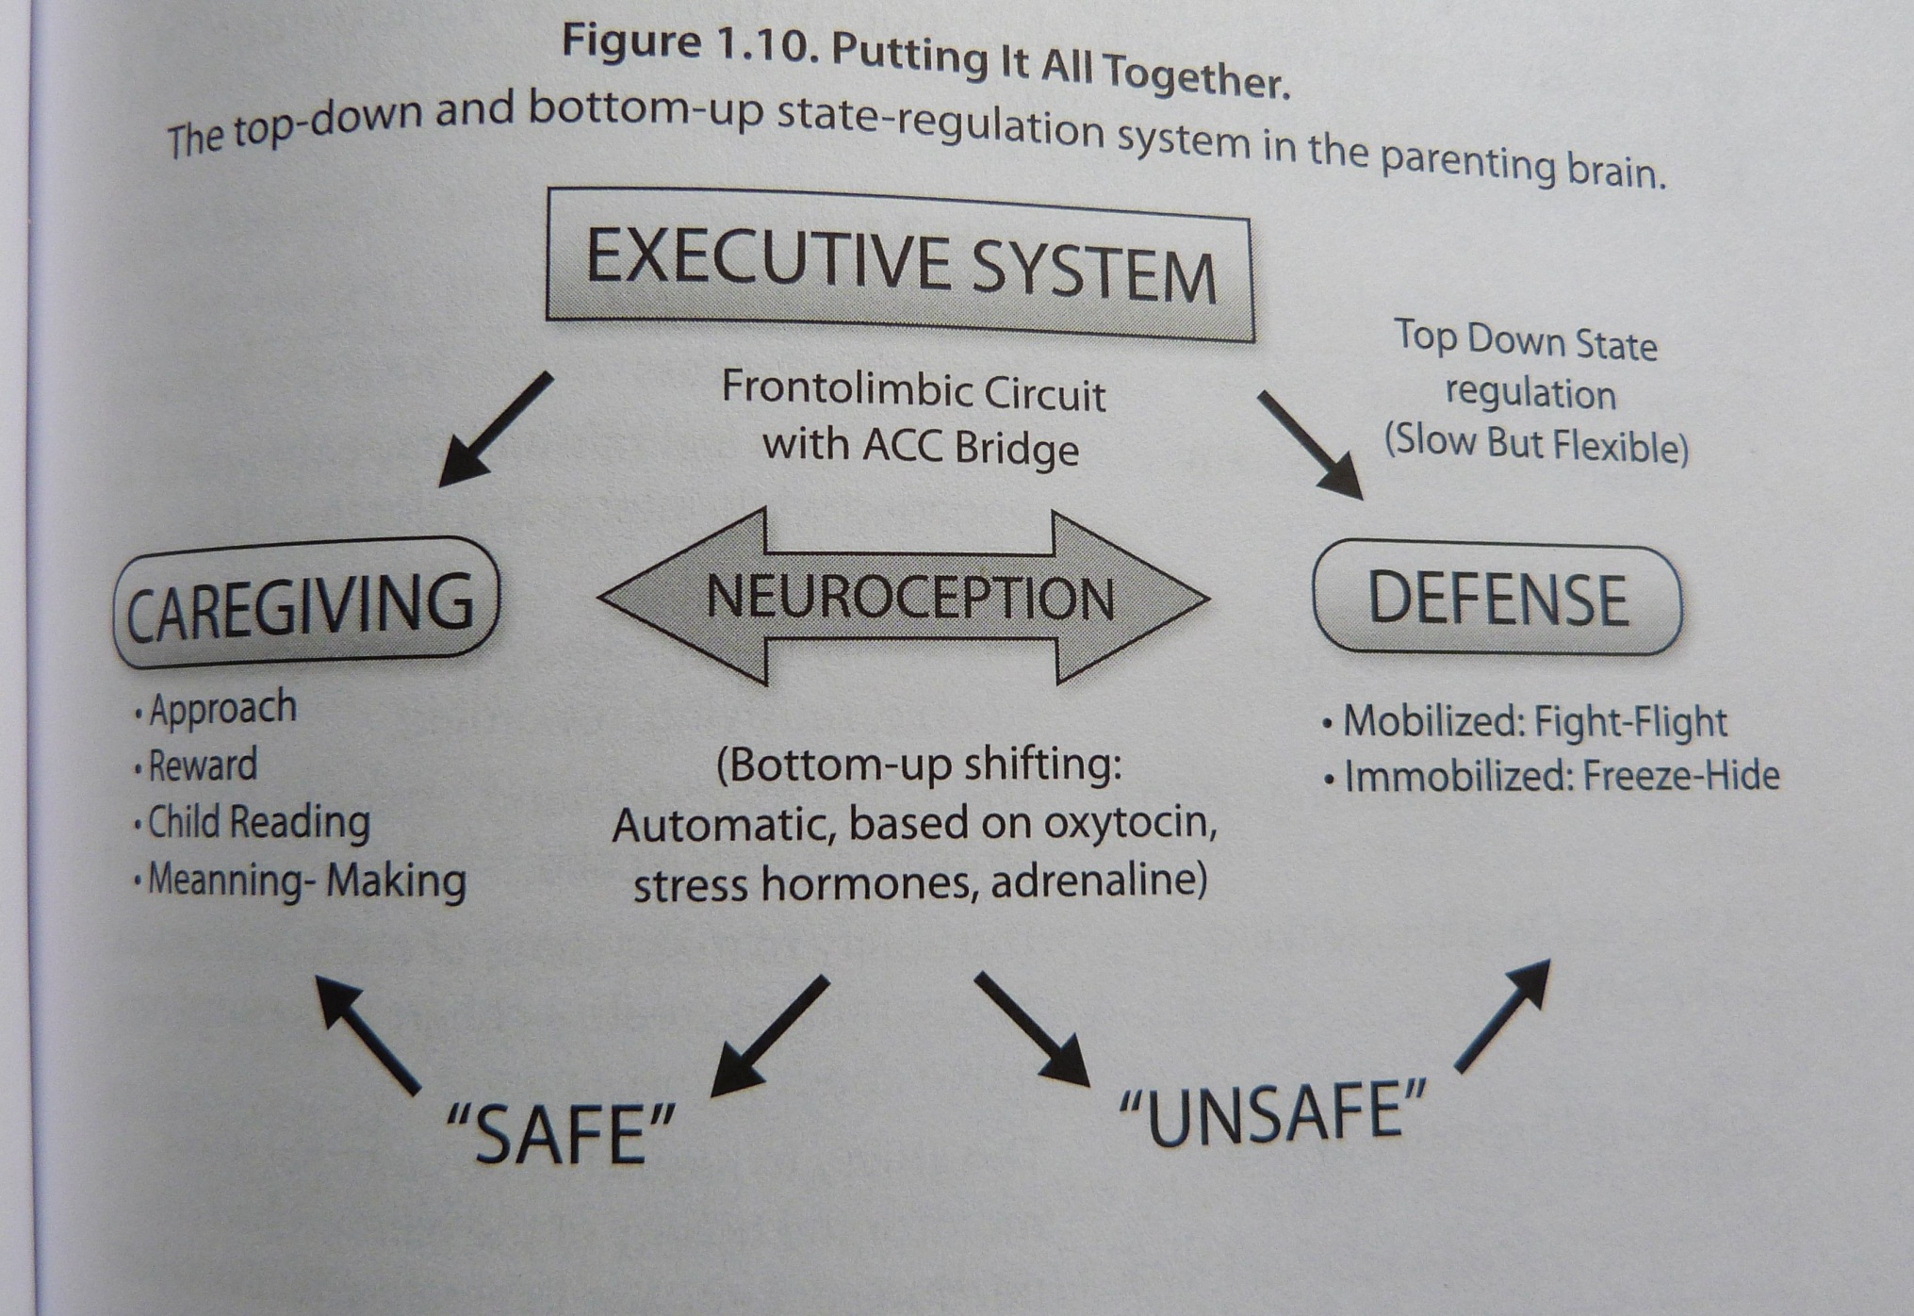

Slide 8
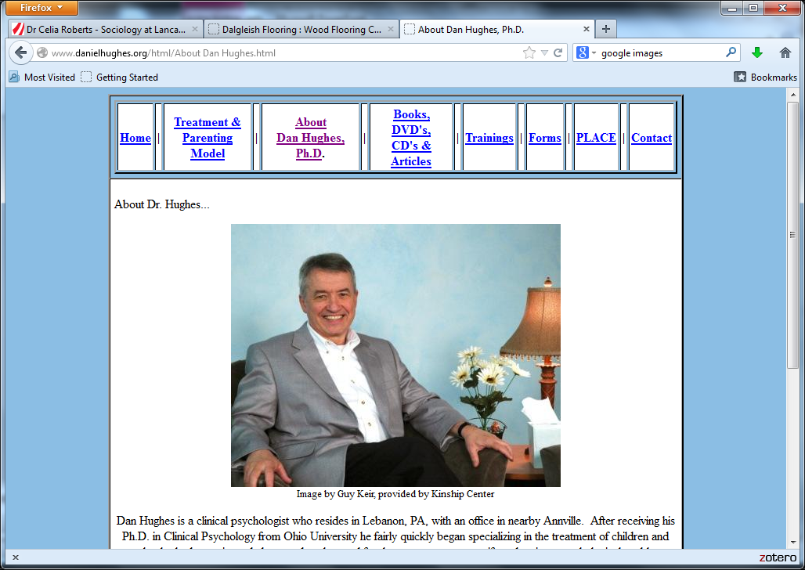
Notes:
http://www.danielhughes.org/html/About%20Dan%20Hughes.html

Slide 9
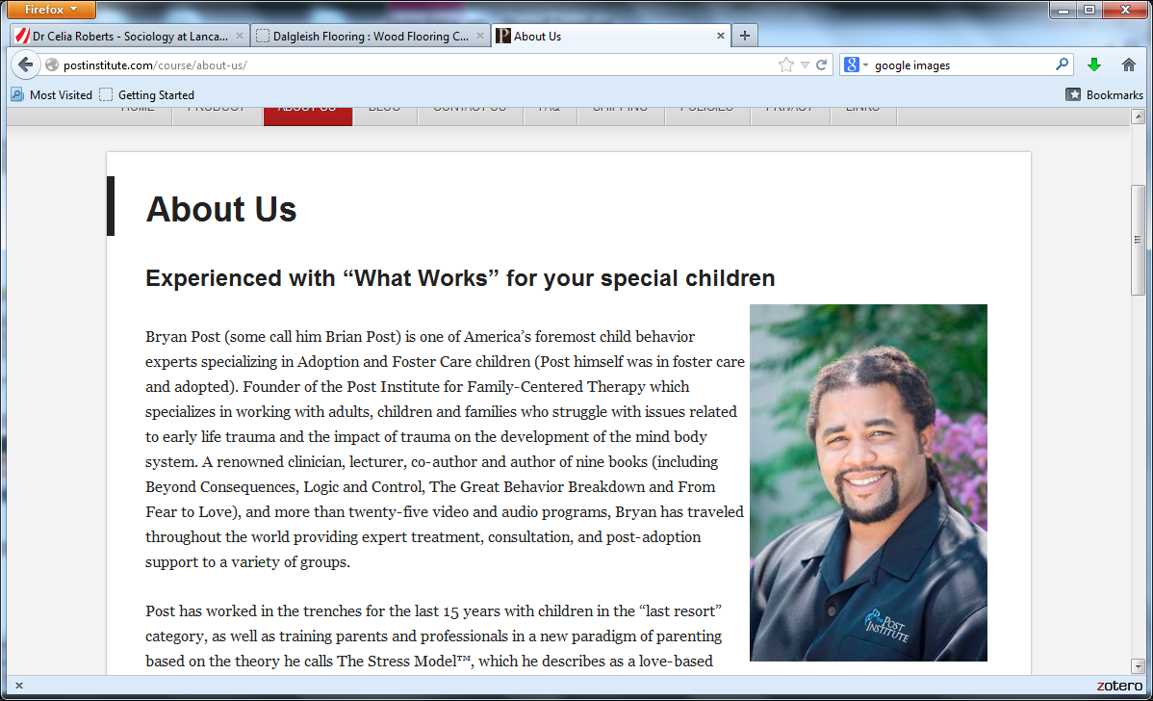
Notes:
http://postinstitute.com/course/about-us/

Slide 10
Dear Adrian
The bad news is that only 90% of parents and adults who’ve reported trying the Oxytocin Factor nasal spray supplement that I’ve written and spoke about have reported positive results. 10% say they haven’t experienced anything at all! Of the 10% the company that makes Oxytocin Factor, ABC Nutriceuticals, says that after they’ve heard that a customer is not experiencing any effect, they’ve sent out a new bottle and of those so far 30% say that indeed it provides them with the “nice, calming effect” that it’s been reported to provide. … Just go to www.oxytocinfactor.com.
As I’ve said before, I am a paid consultant to ABC Nutriceuticals. I feel very confident about this supplement. (from bryanpost1@gmail.com, 23 November 2011)

Slide 11


